Slide 1


Do you live or died?
Titanic dataset: Logistic Regression
Survival Prediction
Assignment 7: 17.02.22

Slide 2
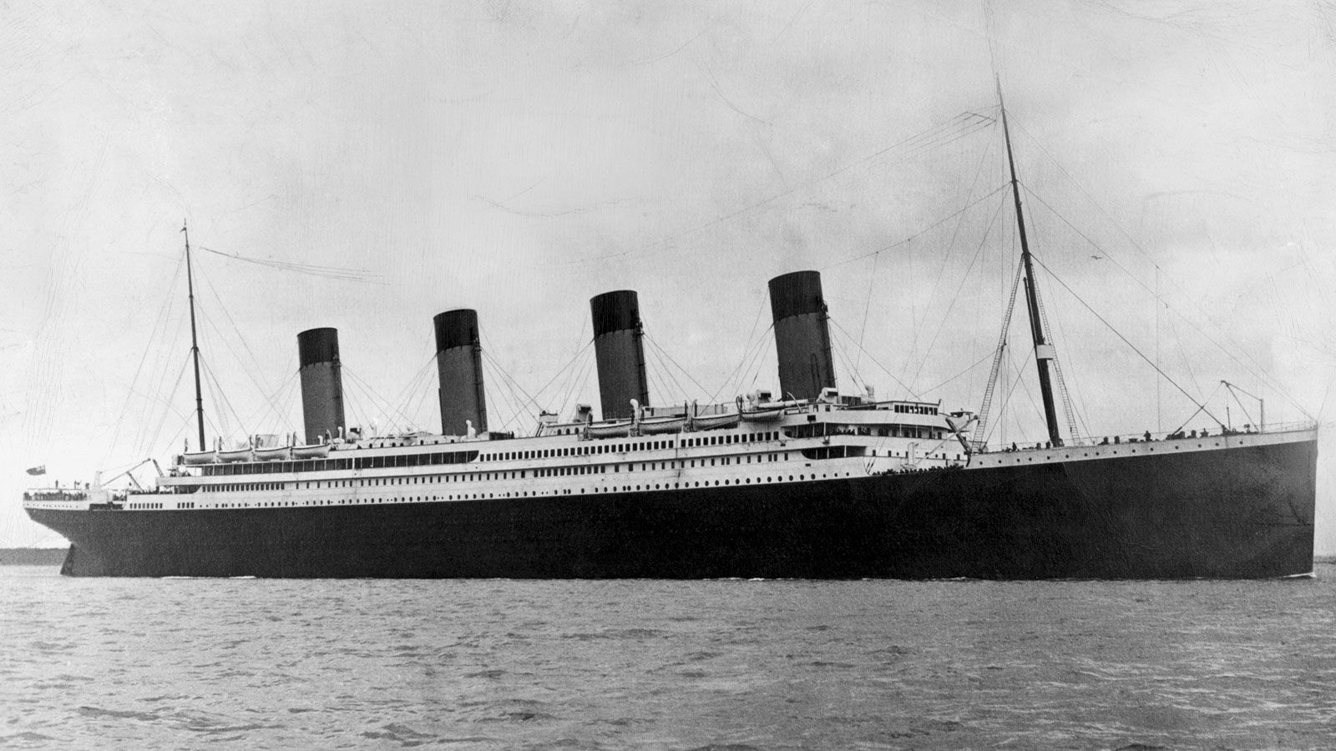

Table of Contents
Topics Covered
Problem vs solution
Get & Explore data
Prepare data
Shortlist Models
Kindly delete this note after editing this page. Thank you!

Slide 3

Problem & Solutions

Slide 4


Survival: could we model your luck?
Basic Descriptive Statistics
Regression Models:
Logistic Regression
Naïve Bayes
Decision Trees

Slide 5

Extract & Explore

Slide 6

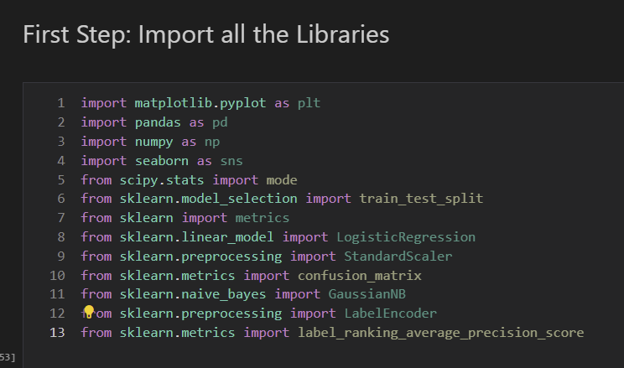
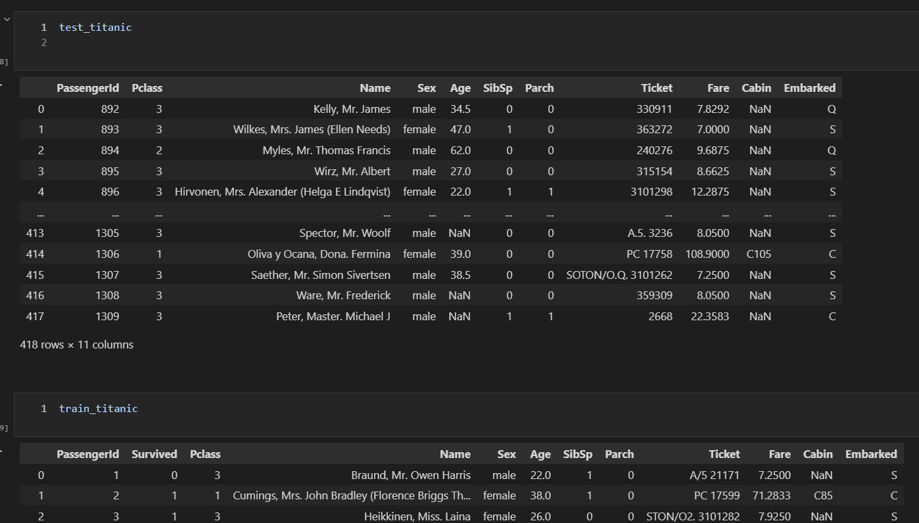
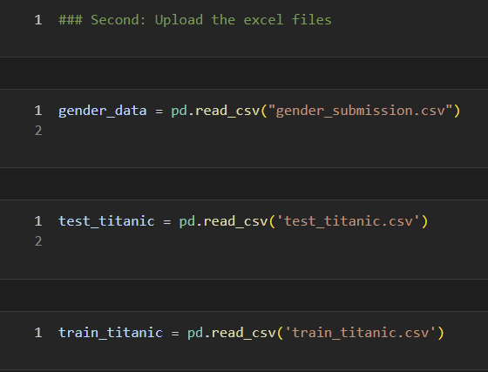

Extract and Explore
Briefly elaborate on what you want to discuss.

Slide 7
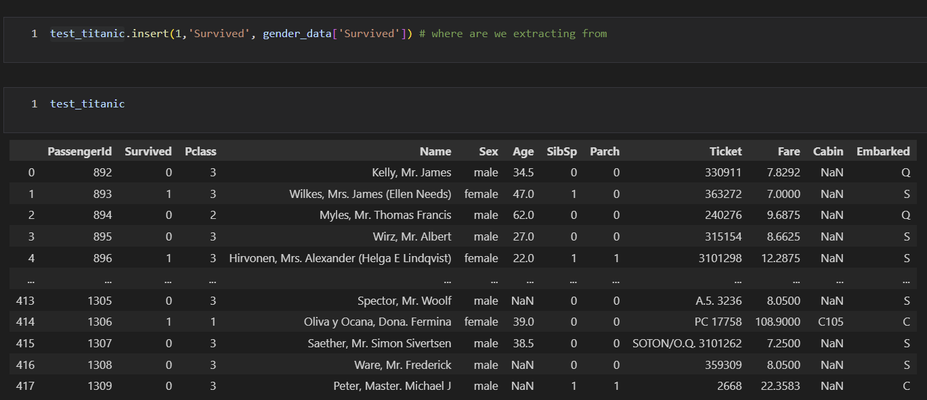
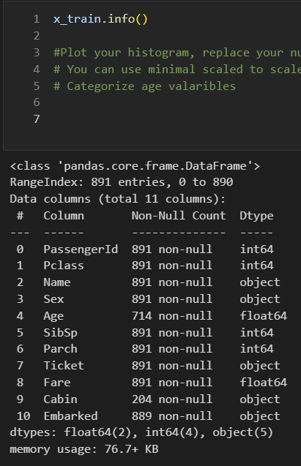
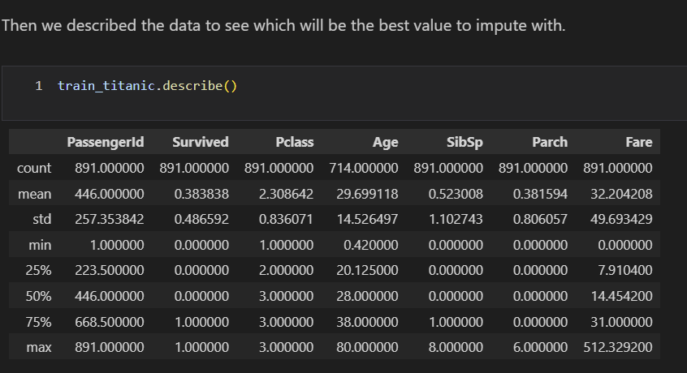
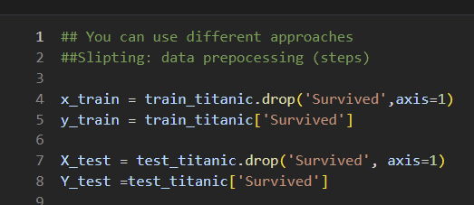
Add Survival data from gender
Briefly elaborate on what you want to discuss.

Slide 8

Treating Missing Data
Imputation & Create new variables

Slide 9
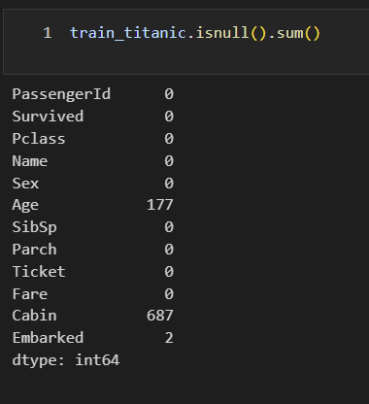
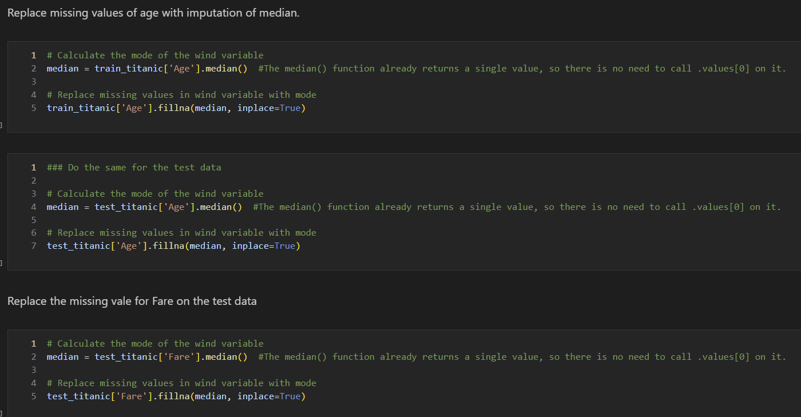
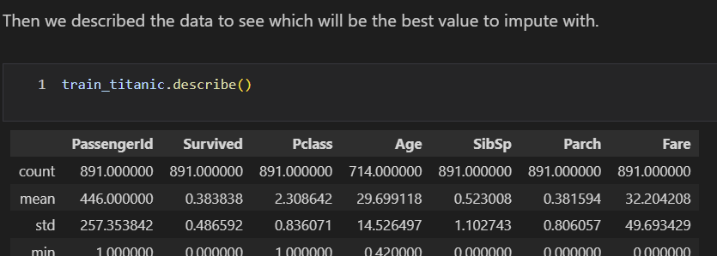
Treat Age Missing data

Slide 10
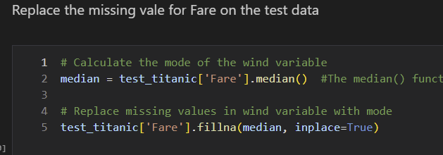
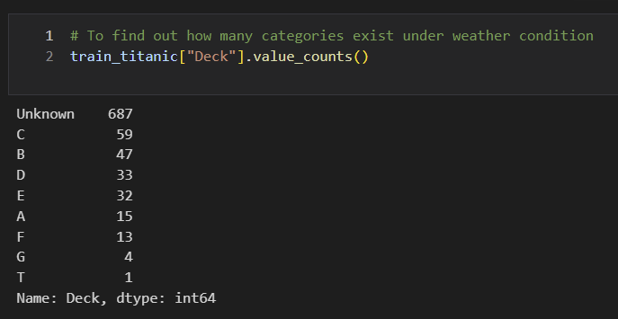
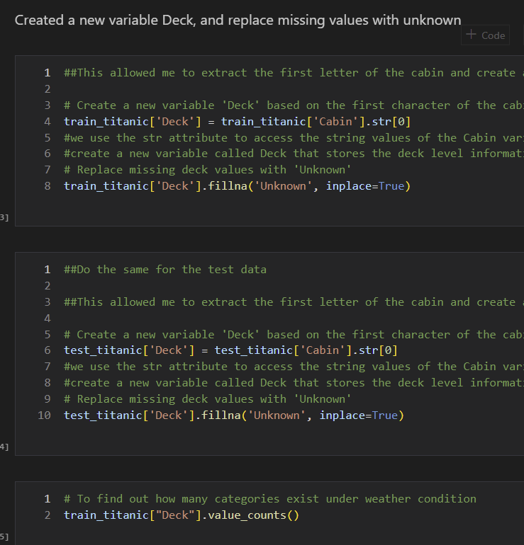
Treat Cabin Missing data

Slide 11
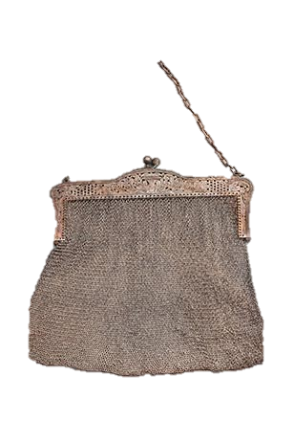
Descriptive Statistics: train data

Slide 12
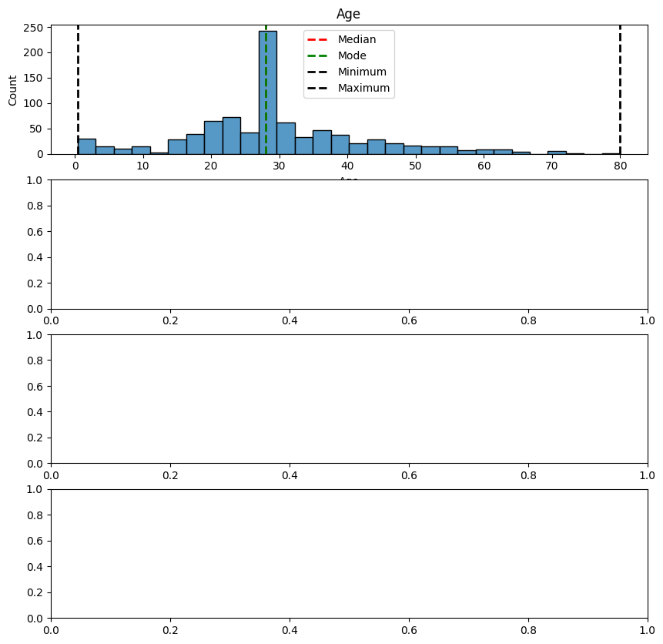
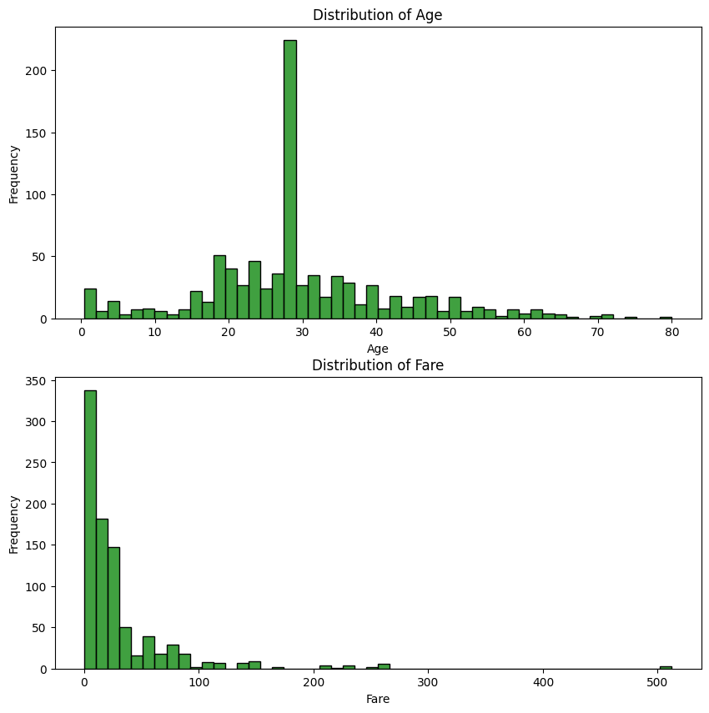
The average passengers were 29 years old
Median of 14.45 per ticket

Slide 13
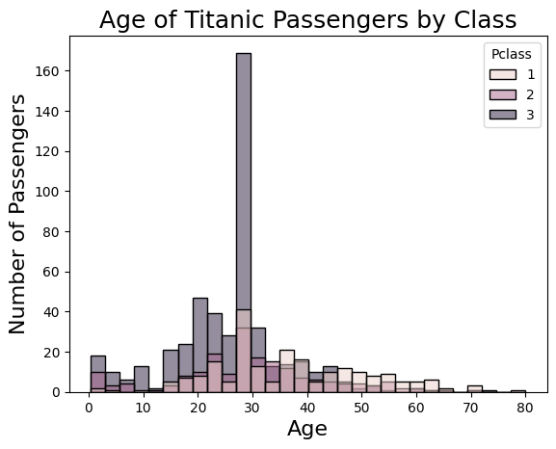
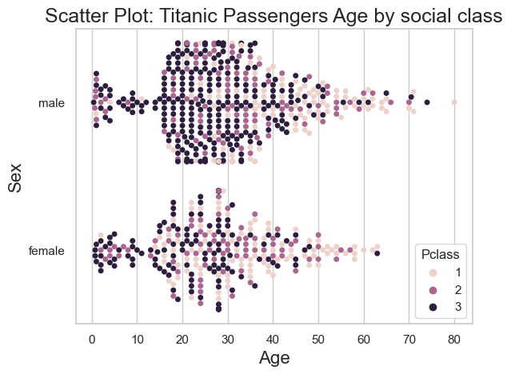
High proportion of younger passengers were 3rd Class
Older Man were more common compared with women

Slide 14
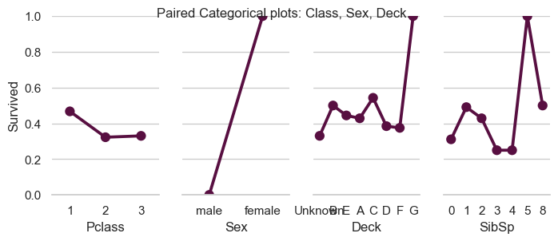
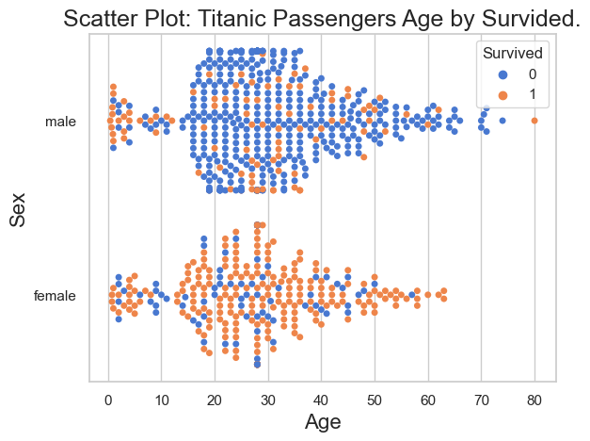
Categorical Plots vs Survival
Men were more likely to have died

Slide 15
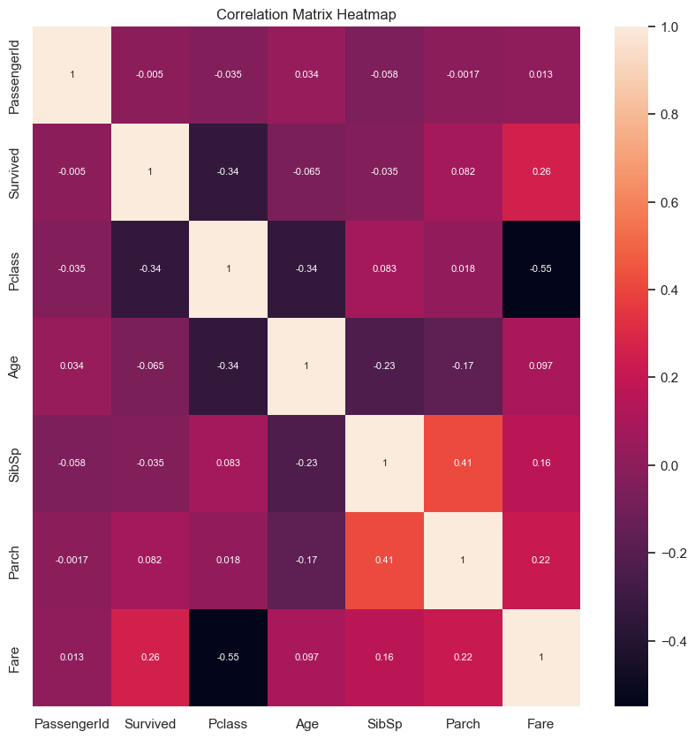
Correlations
No significant correlation
Improvements: Could have transformed variable Sex

Slide 16



Machine Learning: Modelling Logistic Regression
Logistic Regression
Train vs Test
Navies Bayes
Decision Tree

Slide 17
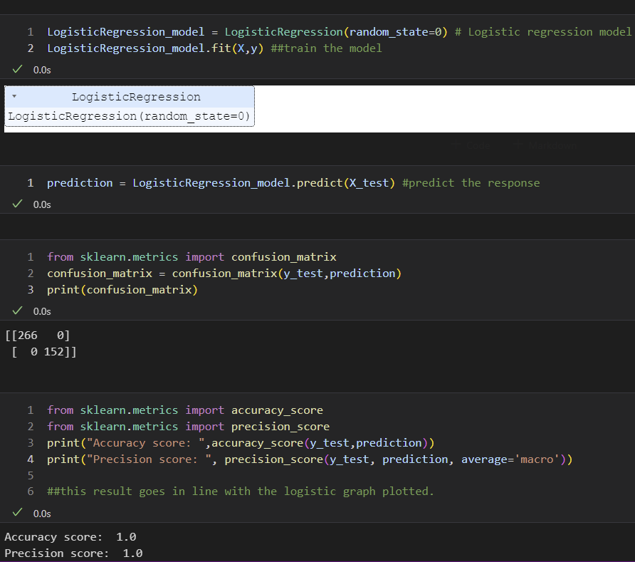
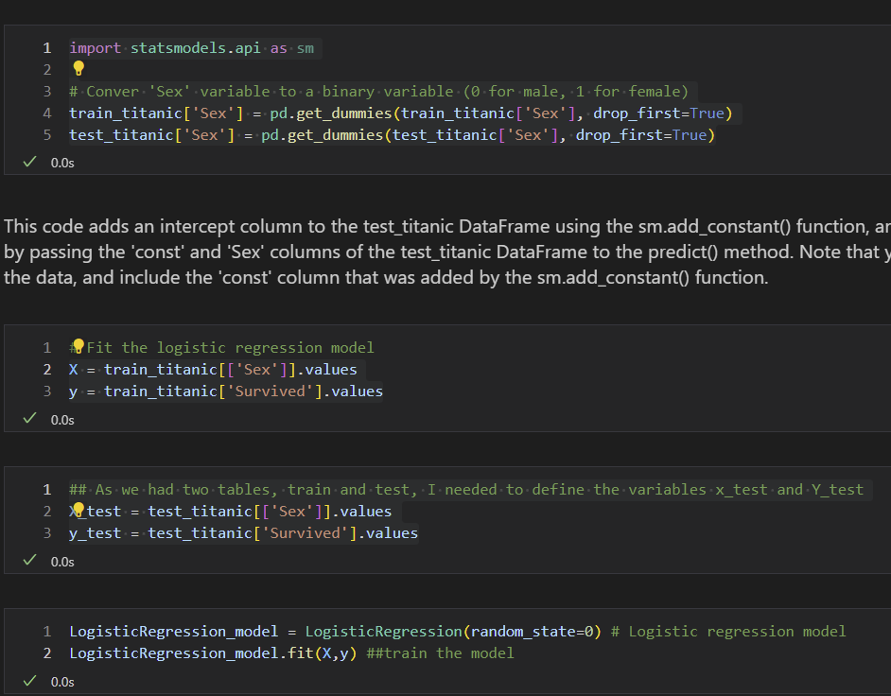
Logistic Regression: We predicted survival by an accuracy of 100% on test data
How come?
Modelling Survived based on sex

Slide 18
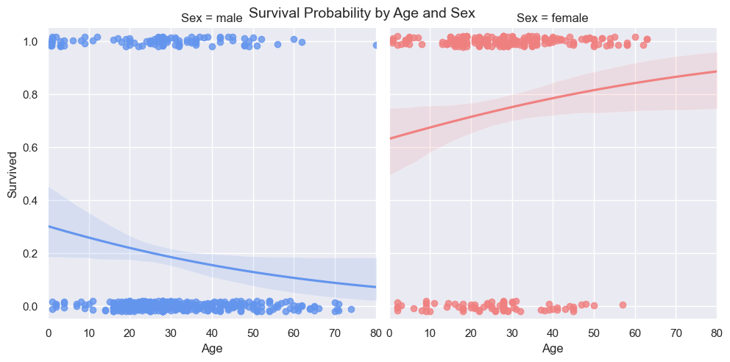
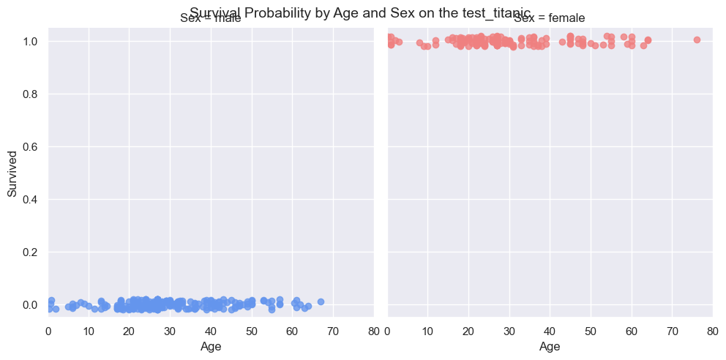
Logistic Regressions
Train data
Test data
This might be a problem when training our model

Slide 19
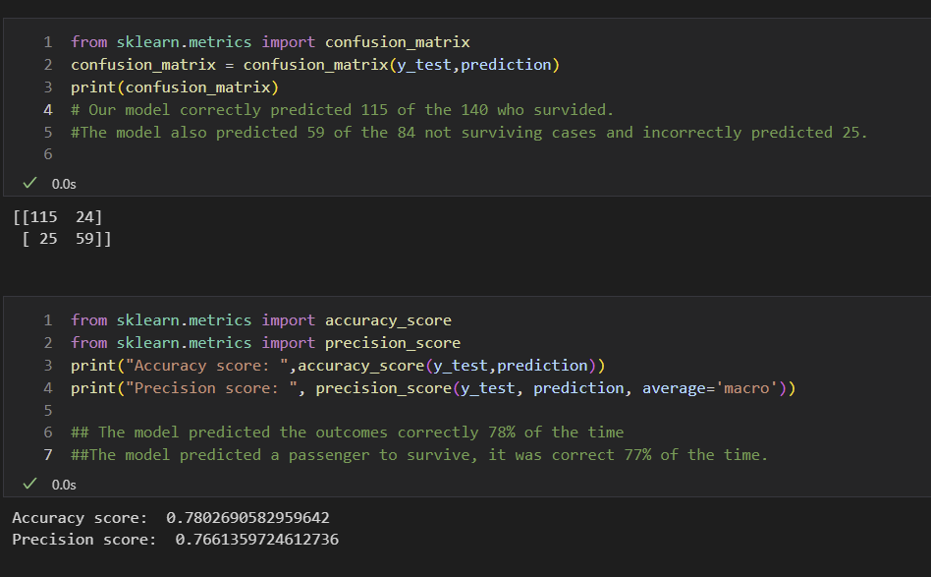
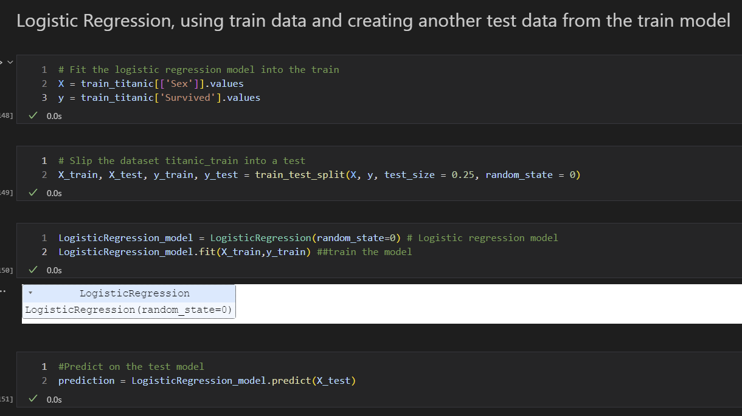
Logistic Regression train: We predicted survival by an accuracy of 78%
Modelling Survived based on sex
Our model correctly predicted 115 of the 140 who survived.
The model also predicted 59 of the 84 not surviving cases and incorrectly predicted 25.

Slide 20


Naïve Bayes
Handles both continuous and discrete data
Small data sets

Slide 21
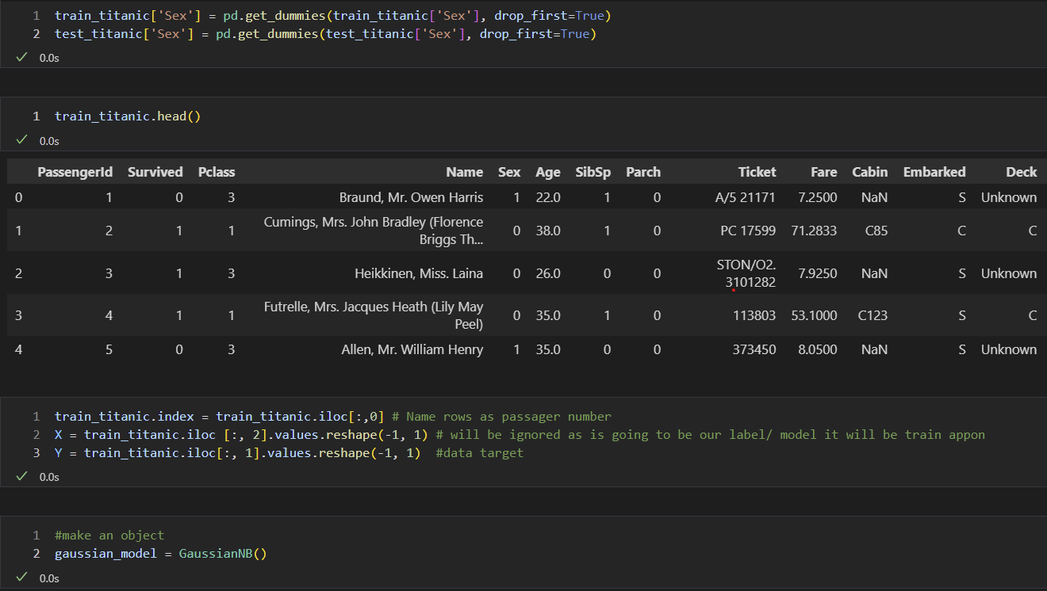
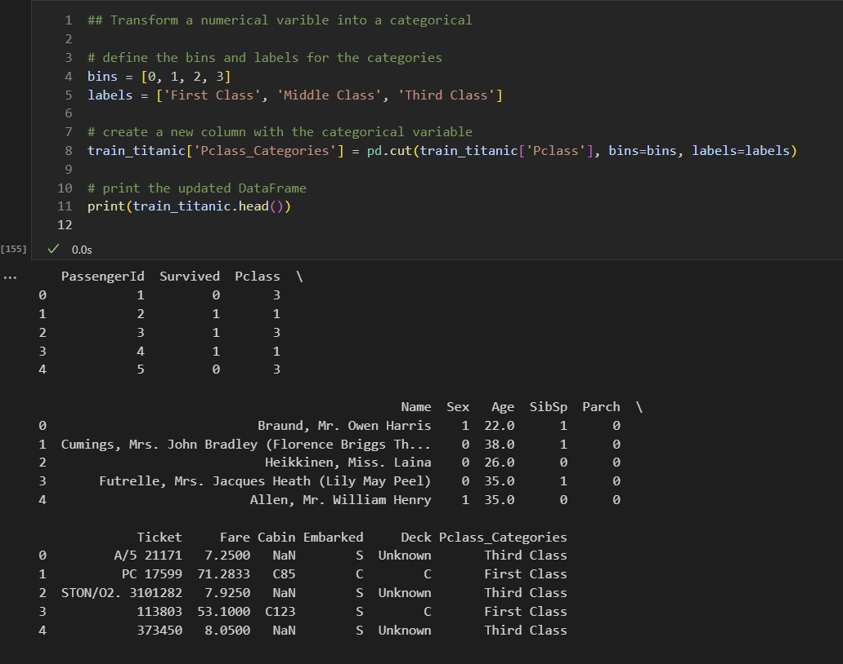
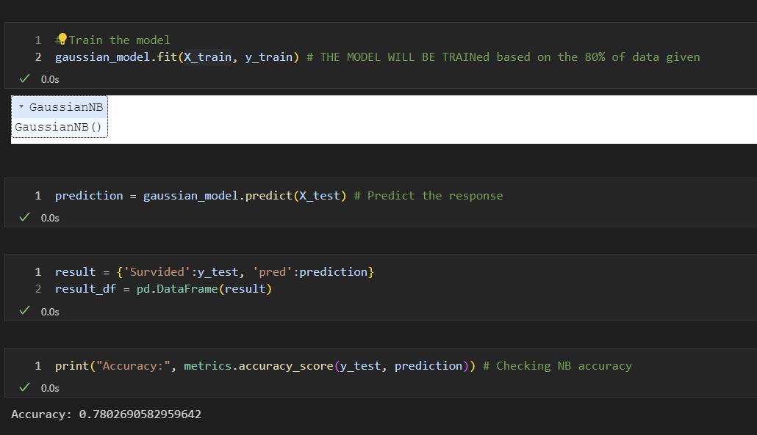
Naïve Bayes: We predicted survival by an accuracy of 78%
Unsure why do we get the same accuracy as the logistic regression
Modelling Survived based on sex

Slide 22
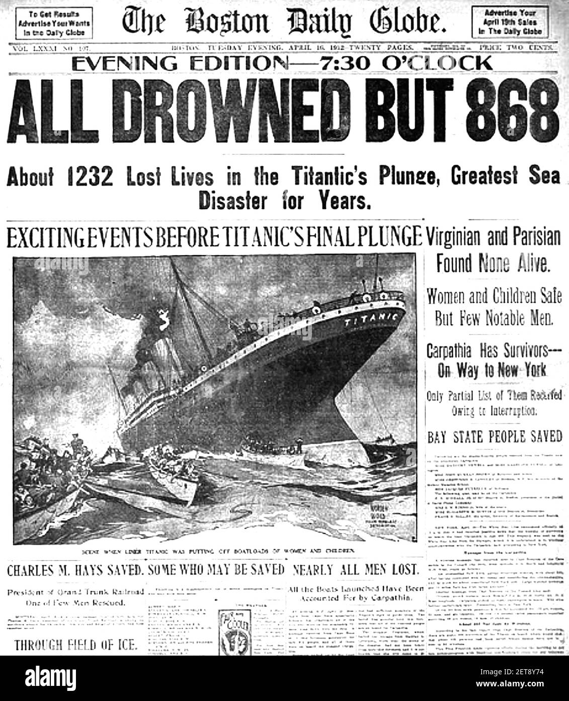

Decision Tree Models
Fast, Efficient, and work with all kinds of data, both numerical and categorical ,discrete and continuous.

Slide 23
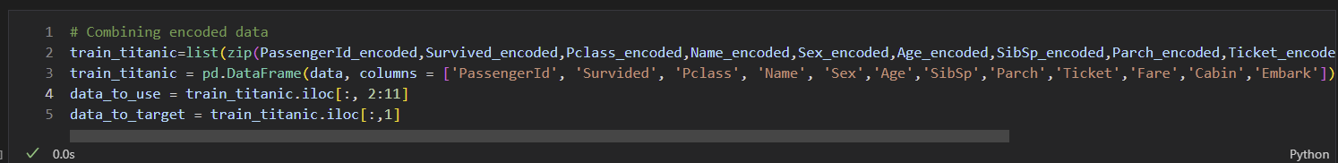
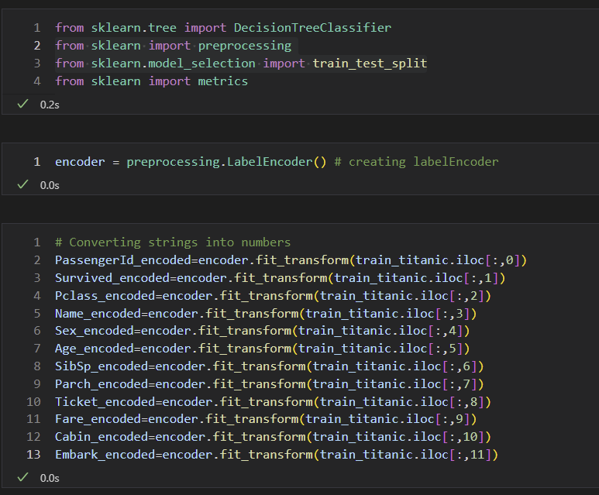
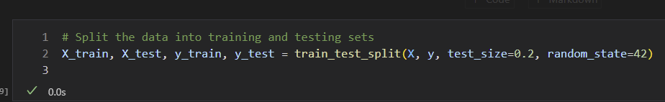
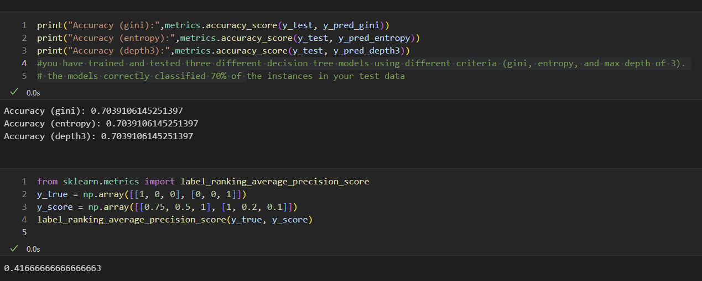
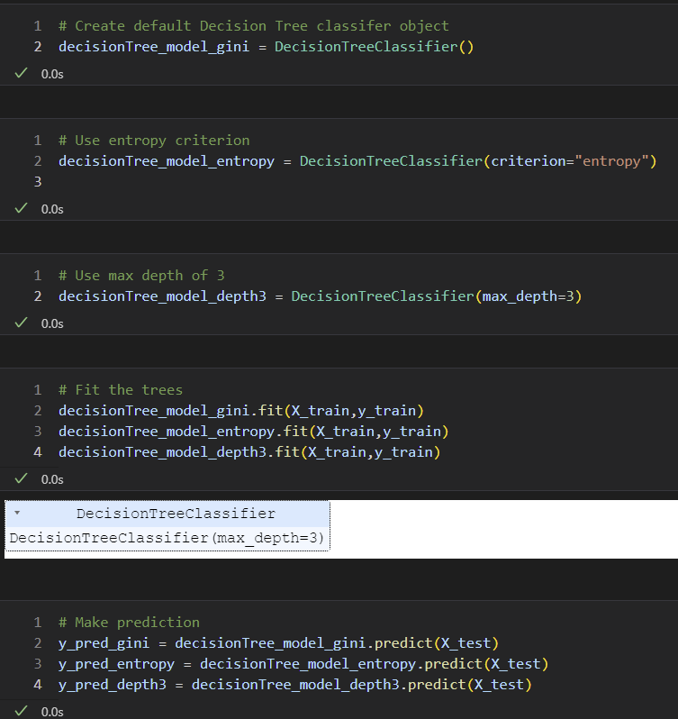
Decision Trees: We predicted survival by an accuracy of 70%
Maybe more variable have less influence in mortality?
Modelling Survived based on all variables

Slide 24









Assumptions
On Survival:
0 mean no survival
Test data was not representative, we break train date into test and train data.
Survival data was based on another column which might not be representative.

Slide 25
Conclusions and lessons learn
Modelling Results have average results. Naive bayes & Logistic Regression were the best model.
I should have started early and spend more time on modelling: I underestimated the time this takes.
Next week: I will start modelling on Tuesday rather Thursday.
If I had more time: learn how to transfer variables from numerical to categorial and categorical to numerical.
Test other variables
More time reading and learning.

Slide 26

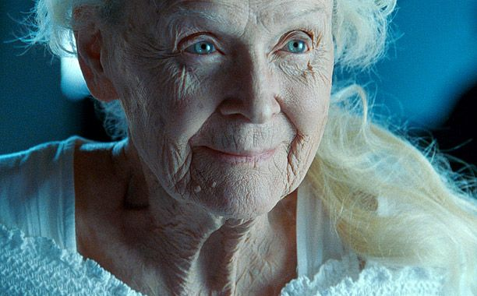
Thank you!
GitHub: https://github.com/eusebiocidalia/

